Slide 1
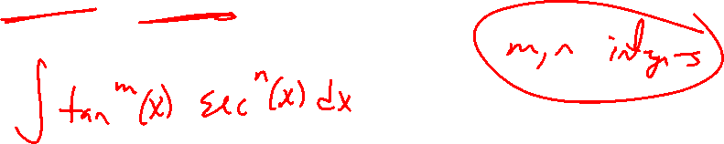
Section 7.2 Trigonometric Integrals
Lecture 3
Tangent and Secant Combinations

Slide 2
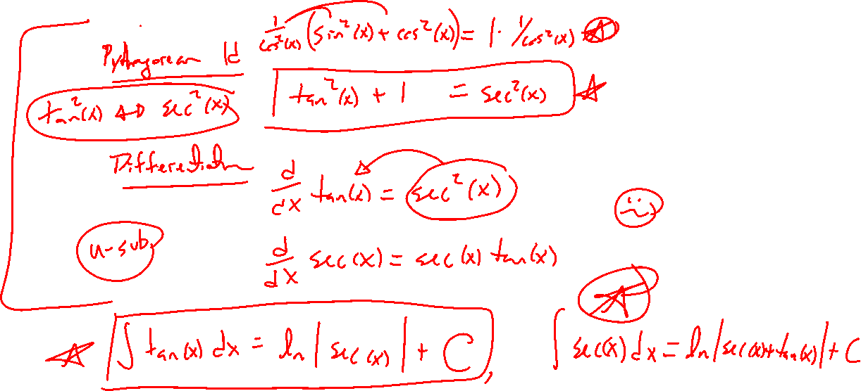
Key Tangent and Secant Connections
Notes:
Pythagoras (change sine into cosine or visa versa)
Differentiation (u-substitution)
Will keep this one simpler than sine/cosine

Slide 3
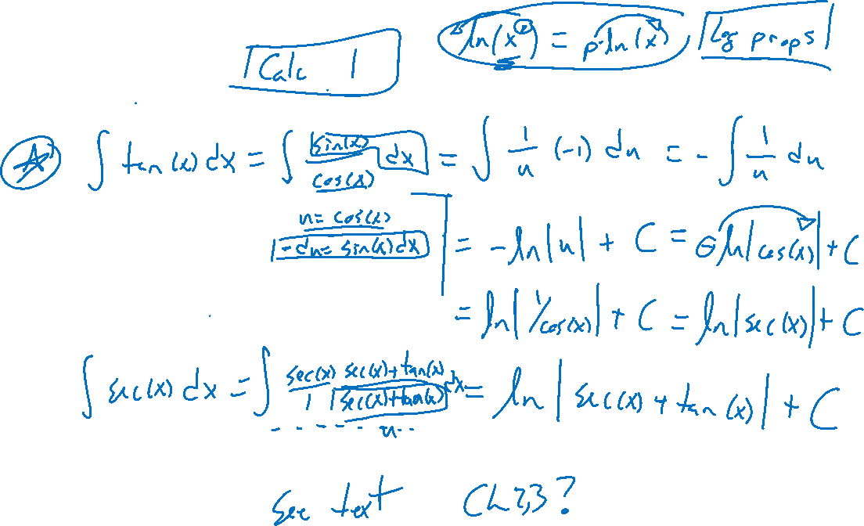
Basic Integrals
Notes:
\int \tan(x) ~dx = \ln|\sec(x)| + C requires u=\cos(x) sub (show)
\int \sec(x) ~dx = \ln|\sec(x)+\tan(x)| + C requires u=\sec(x)+\tan(x) sub (see text, unpleasant)

Slide 4
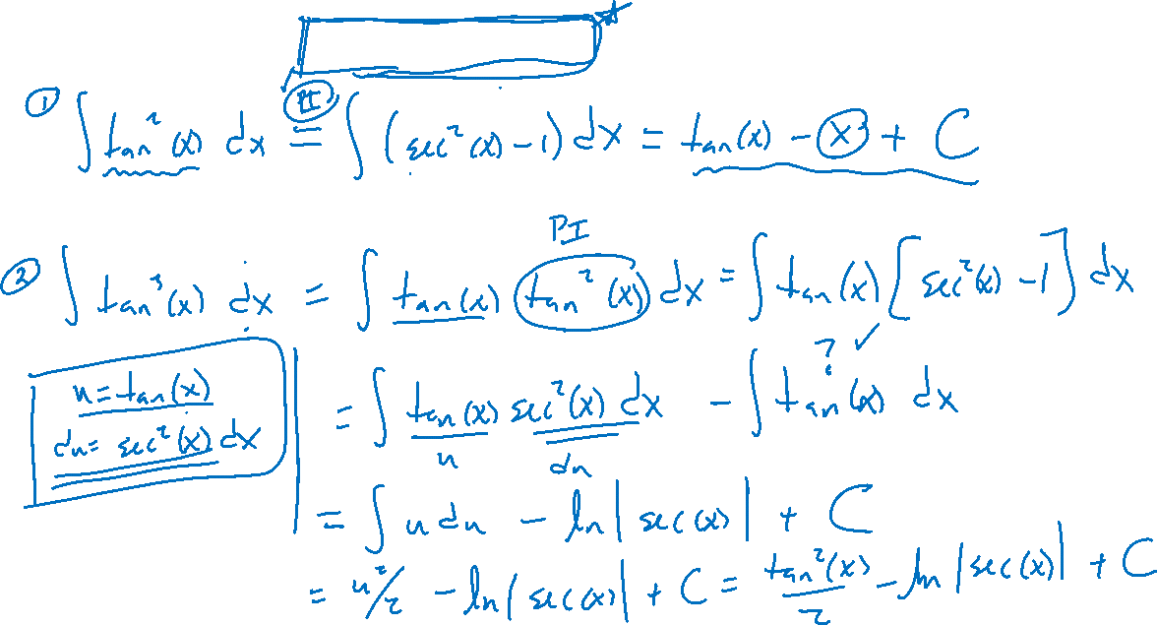
Examples: Try on Own
Notes:
\tan^2(x) (pythagoras then done)
\tan^3(x) (pythagoras then separate for u-sub)

Slide 5
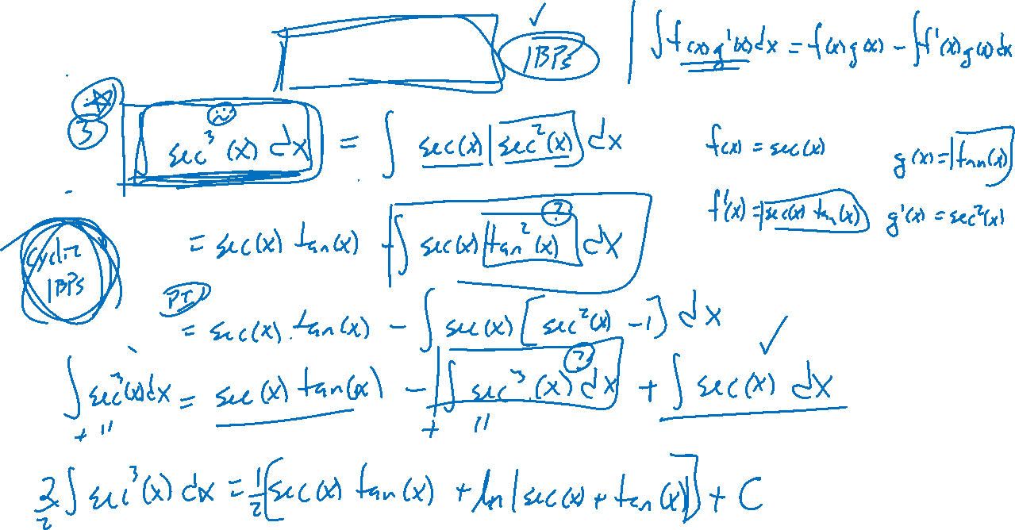
Examples: Try on Own
Notes:
sec^3(x), cyclic integration by parts

Slide 6
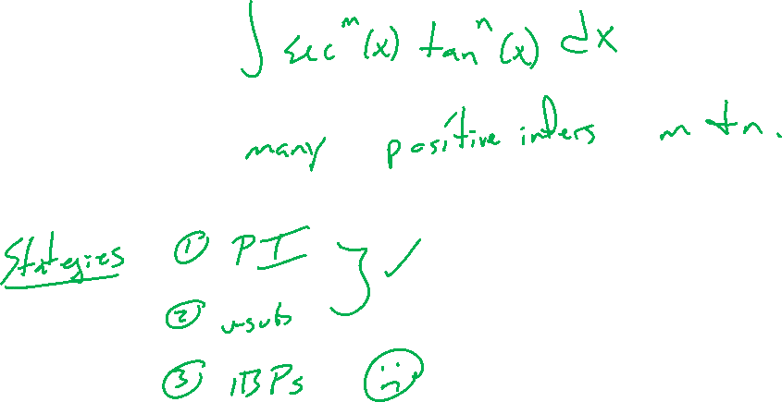
Summary: Tangent/Secant Integrals
Notes:
\int tan^m(x) \sec^n(x) ~dx
Can do for SOME m,n positive integers
Ideas: u-sub or identity (Pythagoras)
Note: no need to consider cot / csc since can transfer into others

Slide 7
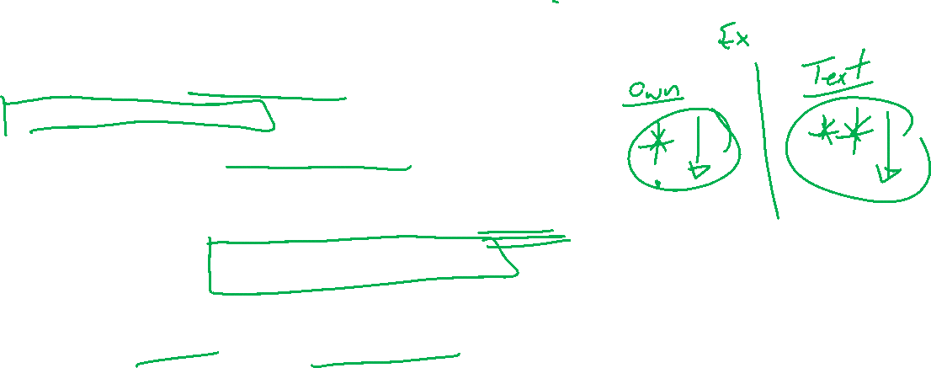
Section 7.2: Textbook Examples and Exercises
Rework examples 1, 2, 4, 5, 6 in the text. Steps:
Write down a problem.
Close the book and attempt on own.
Check / correct your solution against the text solution.
If needed, rewrite the problem to be of the quality of the text solution.
Complete exercises 5, 9, 13, 21, 23, 25, 29
Write solutions of the same quality as in lecture and text solutions.
Check your solution against the answer in the back of the book.

Slide 8

Section 7.2 Homework Submission to Canvas
Preview of section
Skim the section in text and write a short paragraph summary.
Give a bulleted list of all important definitions, theorems, and formulas without details.
Notes on video lectures
Take notes on everything written on slides including all details, worked examples, on-own activities, as well as your own thoughts and questions.
Try on-own activities first, then write down provided solution next to it for comparison.
Worked examples from the text
Write down the problem and attempt without looking at the solution.
Use the solution to write the best explanation you can.
Solutions to textbook exercises
Model approaches and explanations given in the video lectures and textbook examples.
Final reflection of section
List the key takeaways to remember as a bulleted list.

Slide 9
Bonus: History, Mercator Map, and Secant
WIKI: https://en.wikipedia.org/wiki/Mercator_projection
Gilbert Strang: https://ocw.mit.edu/ans7870/resources/Strang/Edited/Calculus/Calculus.pdf
Paper: https://www.maa.org/sites/default/files/pdf/cms_upload/0025570x15087.di021115. 02p0115x.pdf

